Slide 1
CFD Modeling Analysis of a Martian Rotorcraft with Individual Blade Control
Paul Schulman, Xiaobo Tan Smart Microsystems Lab, Michigan State University
Samuel Berndt, Christiahn Roman Jet Propulsion Lab, California Institute of Technology

Slide 2
Outline
Background
Flap dynamics
Flight on Mars
Individual Blade Control
Objective
Methodology
Results
Lift, moment, power
Conclusions
Summary
Questions
References/Contacts
The Mars Helicopter on the surface of Mars as seen by Perseverance’s Mastcam-Z [14].

Slide 3
Background – Rotorcraft
As an airfoil’s angle of attack increases, it produces more lift
On a helicopter, each blade’s pitch (angle of attack) is actuated as a function of its position around the rotor disk
This dissymmetry of lift tilts the thrust vector and moves the helicopter
This blade actuation is achieved by a tilting swashplate

Slide 4
Background – Flap Dynamics
Fully-articulated rotor: blade is free to move about flap and lag hinges
Hingless rotor: flap motion allowed through blade flexibility
Coupling effects
As lift increases, the blade flaps up
As the blade flaps up, the c.o.g. moves inward, and the blade speeds up
Aerodynamic damping
As the blade flaps up, a downward component of flow is imparted on the blade, reducing the angle of attack, reducing the lift, thus reducing the flap
Fully-articulated rotor [15].

Slide 5
Background – Flight on Mars
Atmospheric density: 0.017 kg/m^3
1.293 kg/m^3 on Earth (76 times larger)
Minimal aerodynamic flap damping
Rotor must spin fast → high inertial forces
Very low Reynold’s number
Re = 1e4 to 2.5e4 on Mars
Re = 3e6 to 6e6 on Earth
The big problem
Insufficient flap damping limits rotor diameters to about 1.2 meters
Could make blades stiffer, but this increases mass
Can we design an active flap damping system?
Mars Helicopter rotor system [14].

Slide 6
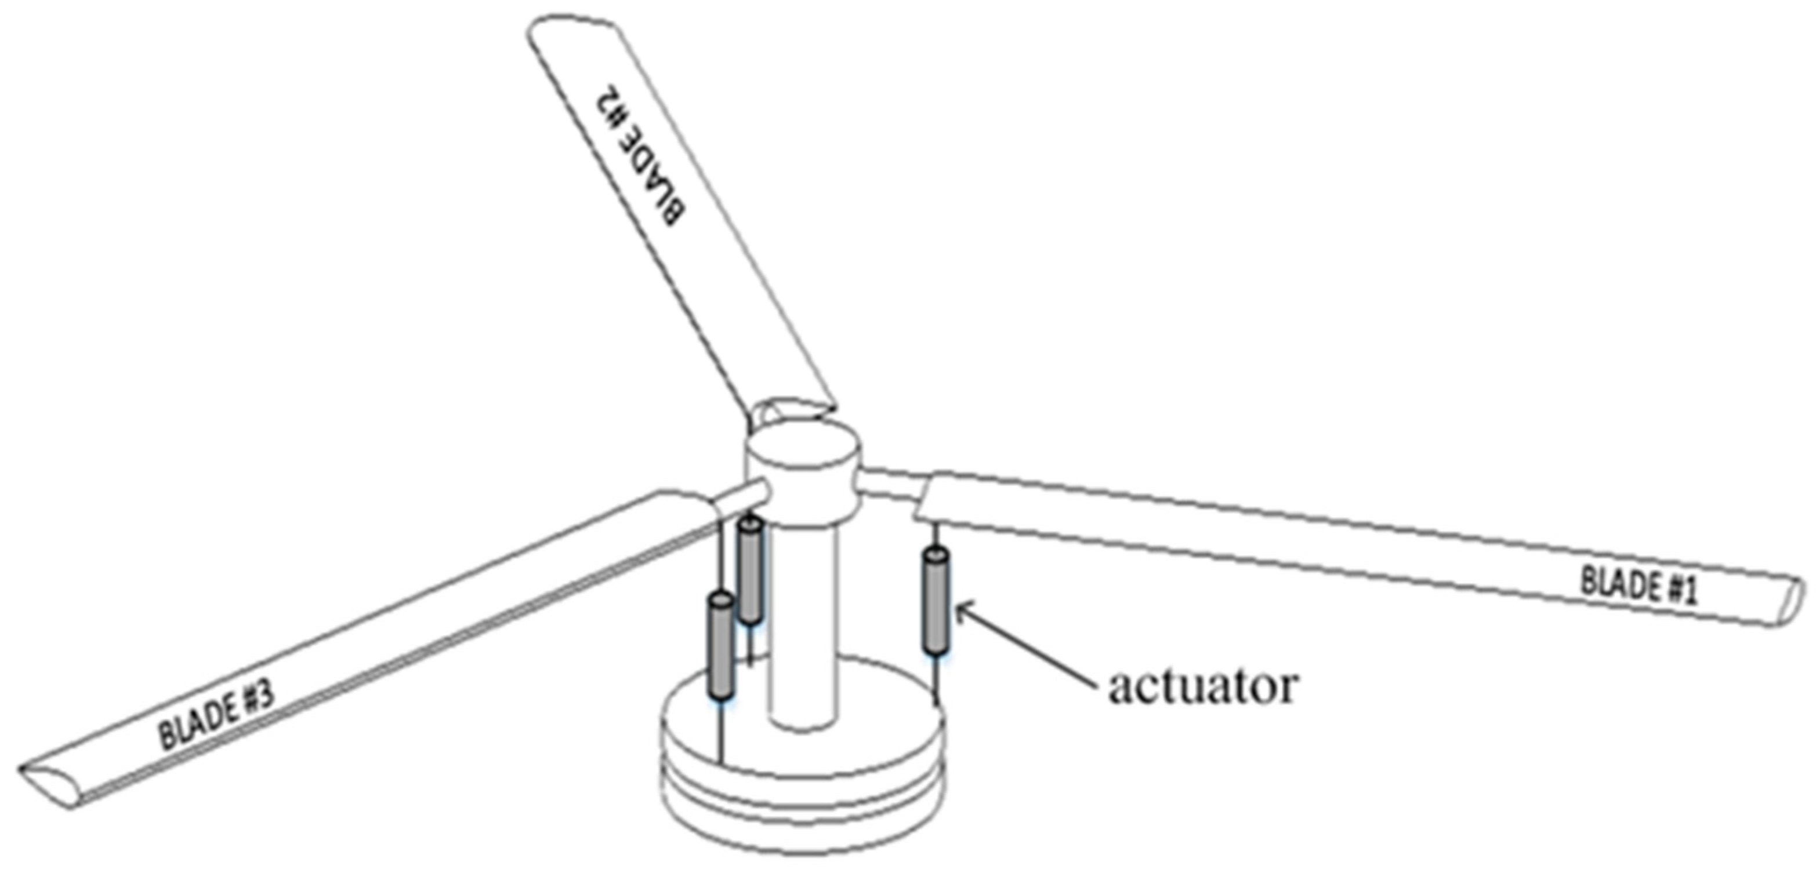
Background - Individual Blade Control
Swashplate system [7].
Swashplates
The Mars Helicopter (and all traditional helicopters) use a swashplate to obtain blade actuation
1/rev sinusoidal blade actuation
Individual Blade Control
An electromechanical actuator at the root of each blade
No inherent limit on actuation frequency, waveform, or phase
IBC system [13].

Slide 7
Objective – CFD Analysis
Goals
To estimate hardware performance and requirements
To estimate force development potential
How
CFD analysis with static and dynamic blade
Outputs
Blade forces and moments
Power at the blade root
Power at the center of the rotor disk

Slide 8
Methodology – ANSYS Fluent
Viscous k-omega SST model with Low Reynold’s number correction
Observed no significant variation with k-epsilon and Spalart-Allmaras methods
Mesh: 1,087,191 tetrahedron elements
Notes:
Minimum edge length: 1.86e-4 meters
Face size: 1.02e-8 to 8.88e-3 square meters
Flow volume: 4.2 x 2.8 x 1.0 meters
Blade position: 0.7 meters from flow inlet
Static case
0.001 second x 250 steps for 0.25 seconds
Dynamic case
5e-5 seconds x 5,000 steps for 0.25 seconds

Slide 9
Methodology – Actuation Waveforms
Three waveforms
Sinusoidal
Skewed sinusoidal
Quadratic
Two peak-to-peak amplitudes
2°, 10°
Two collective inputs (average pitch)
1°, 5°
Five actuation frequencies
1,2,4,6,8/rev

Slide 10
Results – Frequency
Lift vs phase angle
Moment vs phase angle
Key takeaways:
Transient aerodynamic moment and lift vary with blade pitch actuation frequency
Peak aerodynamic moments and lifts do not occur at peak blade pitch
Notes:
2° peak-to-peak sinusoidal actuation centered at 5° angle of attack

Slide 11
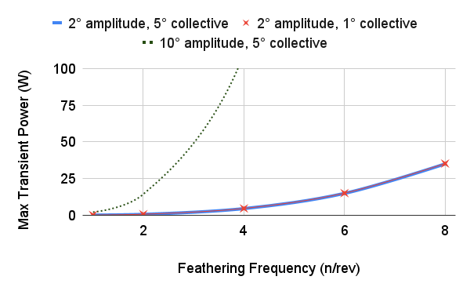
Results – Actuator Max Power
Varying amplitudes and collectives
Varying waveforms
Key takeaways:
Amplitude has large affect
Sinusoidal waveform performs best
A 25 Watt actuator can provide 6/rev, 2° sinusoidal IBC actuation

Slide 12
Results – System Average Power
Varying amplitudes and collectives
Varying waveforms
Key takeaways:
Average rotor power increases with pitching amplitude
Average rotor power sees small increase with increase in pitching frequency

Slide 13
Results – Lift
Varying amplitudes and collectives
Varying waveforms
Key takeaway:
Max lift increases with pitching frequency

Slide 14
Results – Change in Lift
Key takeaways:
The 10° amplitude actuation produces the greatest change in lift but does so at higher power
Higher pitching frequencies produce higher changes in lift
Weight of Mars Helicopter 6.7N on Mars (1.7N per blade)

Slide 15
Conclusions
A 25 Watt actuator can provide 6/rev, 2° sinusoidal IBC actuation and achieve a 2 Newton lift gradient
Rapid pitching of the blade at frequencies higher than 1/rev had a non-negligible affect on the system forces and moments
Lift-pitch slope obtained for many actuation cases

Slide 16
Summary
Flap damping is needed to enable larger rotorcraft on Mars
An active-damping system with Individual Blade Control is proposed
Performance parameters are studied using a CFD analysis
These results can be used to quantify IBC performance in future analyses
Mars Helicopter on its test stand at NASA Jet Propulsion Lab [14].

Slide 17
Questions?
Seitah, Mars, as seen by Ingenuity on its 25th flight [14].

Slide 18
Contact
Paul Schulman
Samuel bernDt
schulm14@msu.edu
248-202-5902
samuel-hunter.berndt@jpl.nasa.gov
626-755-3617
Xiaobo Tan
Christiahn Roman
xbtan@msu.edu
christiahn.roman@jpl.nasa.gov
Smart Microsystems Lab
Jet Propulsion Lab
Electrical and Computer Engineering
Michigan State University
California Institute of Technology
National Aeronautics and Space Administration

Slide 19
References
[1] Grip, H.F., Johnson, W., Malpica, C., Scharf, D.P., Mandic, M., Young, L., Allan, B., Mettler, B., and Martin, M.S., (2017). Flight dynamics of a Mars helicopter. Published on the NASA Technical Report Server, DOCID: 20210007745.
[2] Jacklin, S. A., Swanson, S., Blaas, A., Richter, P., Teves, D., Niesl, G., Kube, R., Gmelin, B., and Key, D. L., (2020). Investigation of a helicopter Individual Blade Control (IBC) system in two full-scale wind tunnel tests: Volume I. Published on the NASA Technical Report Server, DOCID: 20205003457.
[3] Park, J.-S., Kim, D.-H., Chase, S., Lee, Y.-L., Go, J.-I., (2019). Vibration and performance analyses using individual blade pitch controls for lift-offset rotors. International Journal of Aerospace Engineering, Article ID 9589415.
[4] Norman, T.R., Theodore, C., Shinoda, P., Fuerst, D., Arnold, U.T.P., Makinen, S., Lorber, P., and O'Neill, J., (2009). Full-scale wind tunnel test of a UH-60 Individual Blade Control system for performance improvement and vibration, loads, and noise control. American Helicopter Society 65th Annual Forum.
[5] Splettstoesser, W. R., Shultz, K.-J., van der Wall, B., Buchholz, H., Gembler, W., and Niesl, G., (2000). Helicopter noise reduction by Individual Blade Control (IBC): selected flight test and simulation results. RTA - AVT Symposium, Number 30. Published on the Defense Technical Information Center, DOCID: ADP011125.
[6] Arnold, U.T.P., and Furst, D., (2005). Closed loop IBC results from CH-53G flight tests. Aerospace Science and Technology, Volume 9, pp. 421-435. DOI: 10.1016/j.ast.2005.01.014.
[7] Rotaru, C. and Todorov, M., (2017). Helicopter Flight Physics. Flight Physics – Models, Techniques and Technologies. InTech. DOI: 10.5772/intechopen.7156.
[8] Saxena, A. and Chopra, I., (2020). Wind tunnel testing of a swashplateless rotor with compact brushless motor actuated flaps for primary control. Journal of the American Helicopter Society, Volume 65, Number 1, pp. 1-6. DOI: 10.4050/JAHS.65.012010.
[9] Noonan, K.W., and Bingham, G.J., (1980). Aerodynamic characteristics of three helicopter rotor airfoil sections at Reynolds numbers from model scale to full scale at Mach numbers from 0.35 to 0.90. Technical publication. Published on the NASA Technical Report Server, DOCID: 19800023826.
[10] Koning, W.J.F., Romander, E.A., and Johnson, W., (2018). Low Reynolds number airfoil evaluation for the Mars Helicopter rotor. Presented at the American Helicopter Society International 74th Annual Forum and Technology Display. Published on the NASA Technical Report Server, DOCID: 20180008702.
[11] Alam, M.M., Zhou, Y., Yang, H.X., Guo, H., and Mi, J., (2009). The ultra-low Reynolds number airfoil wake. Experimental Fluids 48, pp. 81-103. Springer. DOI: 10.1007/s00348-009-0713-7.
[12] Pipenberg, B.T., Keenoon, M., Tyler, J., Hibbs, B., Landberg, S., Balaram, B., Grip, H.F., and Pempejian, J., (2019). Design and fabrication of the Mars Helicopter rotor, airframe, and landing gear system. AIAA Scitech 2019 Forum. DOI: 10.2514/6.2019-0620.
[13] Yang, R., Gao, Y., Wang, H., and Ni, X., (2022). Reducing helicopter vibration loads by individual blade control with genetic algorithm. Machines. DOI: 10.3390/machines10060479.
[14] NASA Science Mars Exploration Images. National Aeronautics and Space Administration. Accessed 28 September 2023. https://mars.nasa.gov/multimedia/images.
[15] Marichal, N. G., Tomas-Rodriguez, M., Hernandez, A., Castillo-Rivera, S., and Campoy, P., (2013). Vibration reduction for vision systems on board unmanned aerial vehicles using a neuro-fuzzy controller. Journal of Vibration and Control. DOI: 10.1177/1077546313479632.

